Slide 1
Notes:
Now, that might be overselling Economics, "the dismal science", as a discipline, comparing it to Physics.
It seems to me that Kent Beck understood that something similar was true in Software.
Risk was that underlying physics of building software.
I’ve come to the same realisation, and I’m going to spend a couple of minutes now trying to persuade you why that’s true.

Slide 2
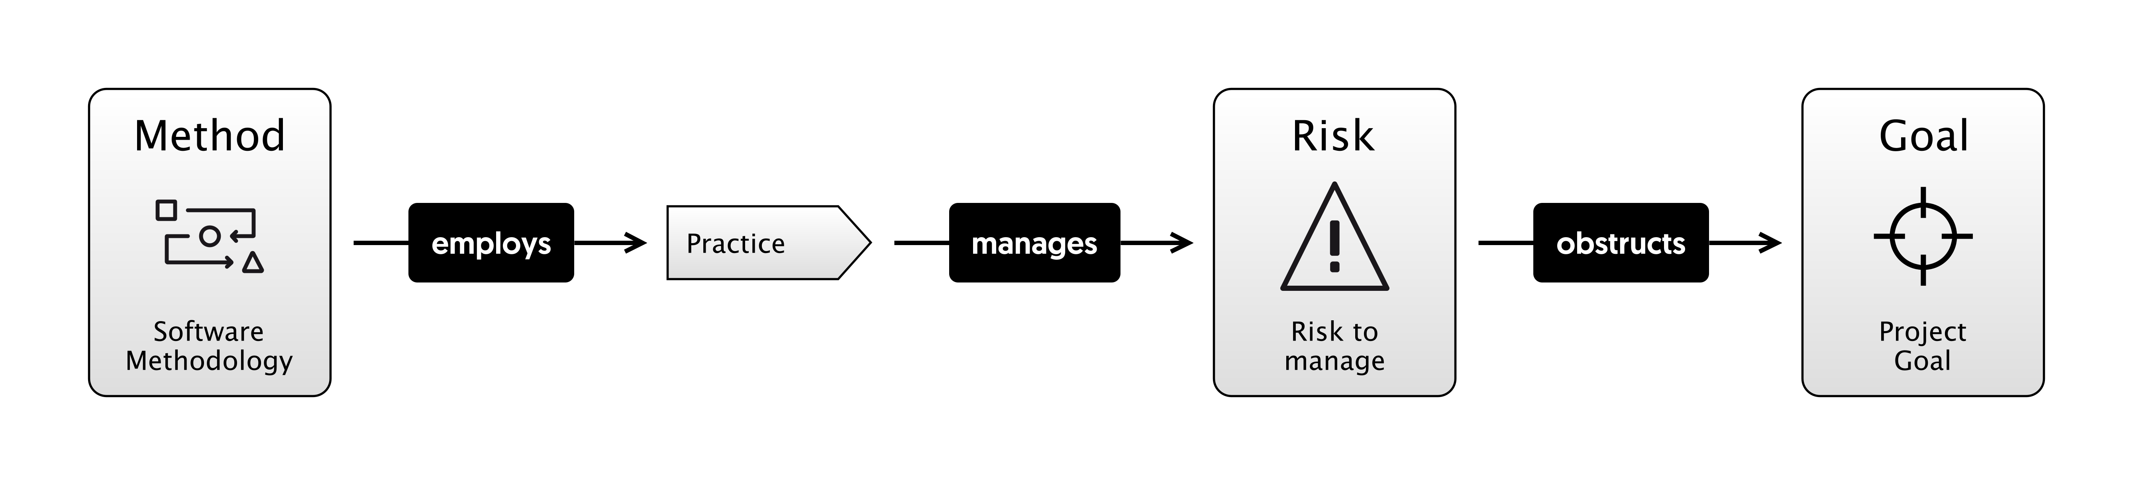
Notes:
That is, methodologies like Scrum, XP, Waterfall are collections of practices like Unit Testing, Standups and so on. And these practices are meant to manage risk.
Risk is the underlying "physics" that we're dealing with.
And risks are all the things that can go wrong on your project, preventing you from hitting the goal, the vision of reality that you wanted.
I am going to try and make that case in various ways, and then we can try to apply that principle in a number of different scenarios and see where it gets us.
You could argue, like a footballer might, that understanding that lower level isn't going to make a jot of difference to how you do the higher level stuff. How do you run a good retro? How do you do estimating? How do you code a feature?
You can know all that stuff separately.
Actually though, I think, like economics, not only that it is useful, but that we're already doing this stuff anyway, we just don't talk about it.

Slide 3
"THE BASIC PROBLEM OF SOFTWARE DEVELOPMENT IS RISK"
Notes:
So, in order to convince you of this statement, I'm first going to try and convince you of some more specific statements.
Let’s start with..

Slide 4

"THE BASIC PROBLEM OF SOFTWARE DEVELOPMENT IS RISK"
RISK
Notes:
So instead of looking at Software Development for a moment, I’m just going to talk about the board game, Risk.
My son Charlie and I love to play risk.

Slide 5
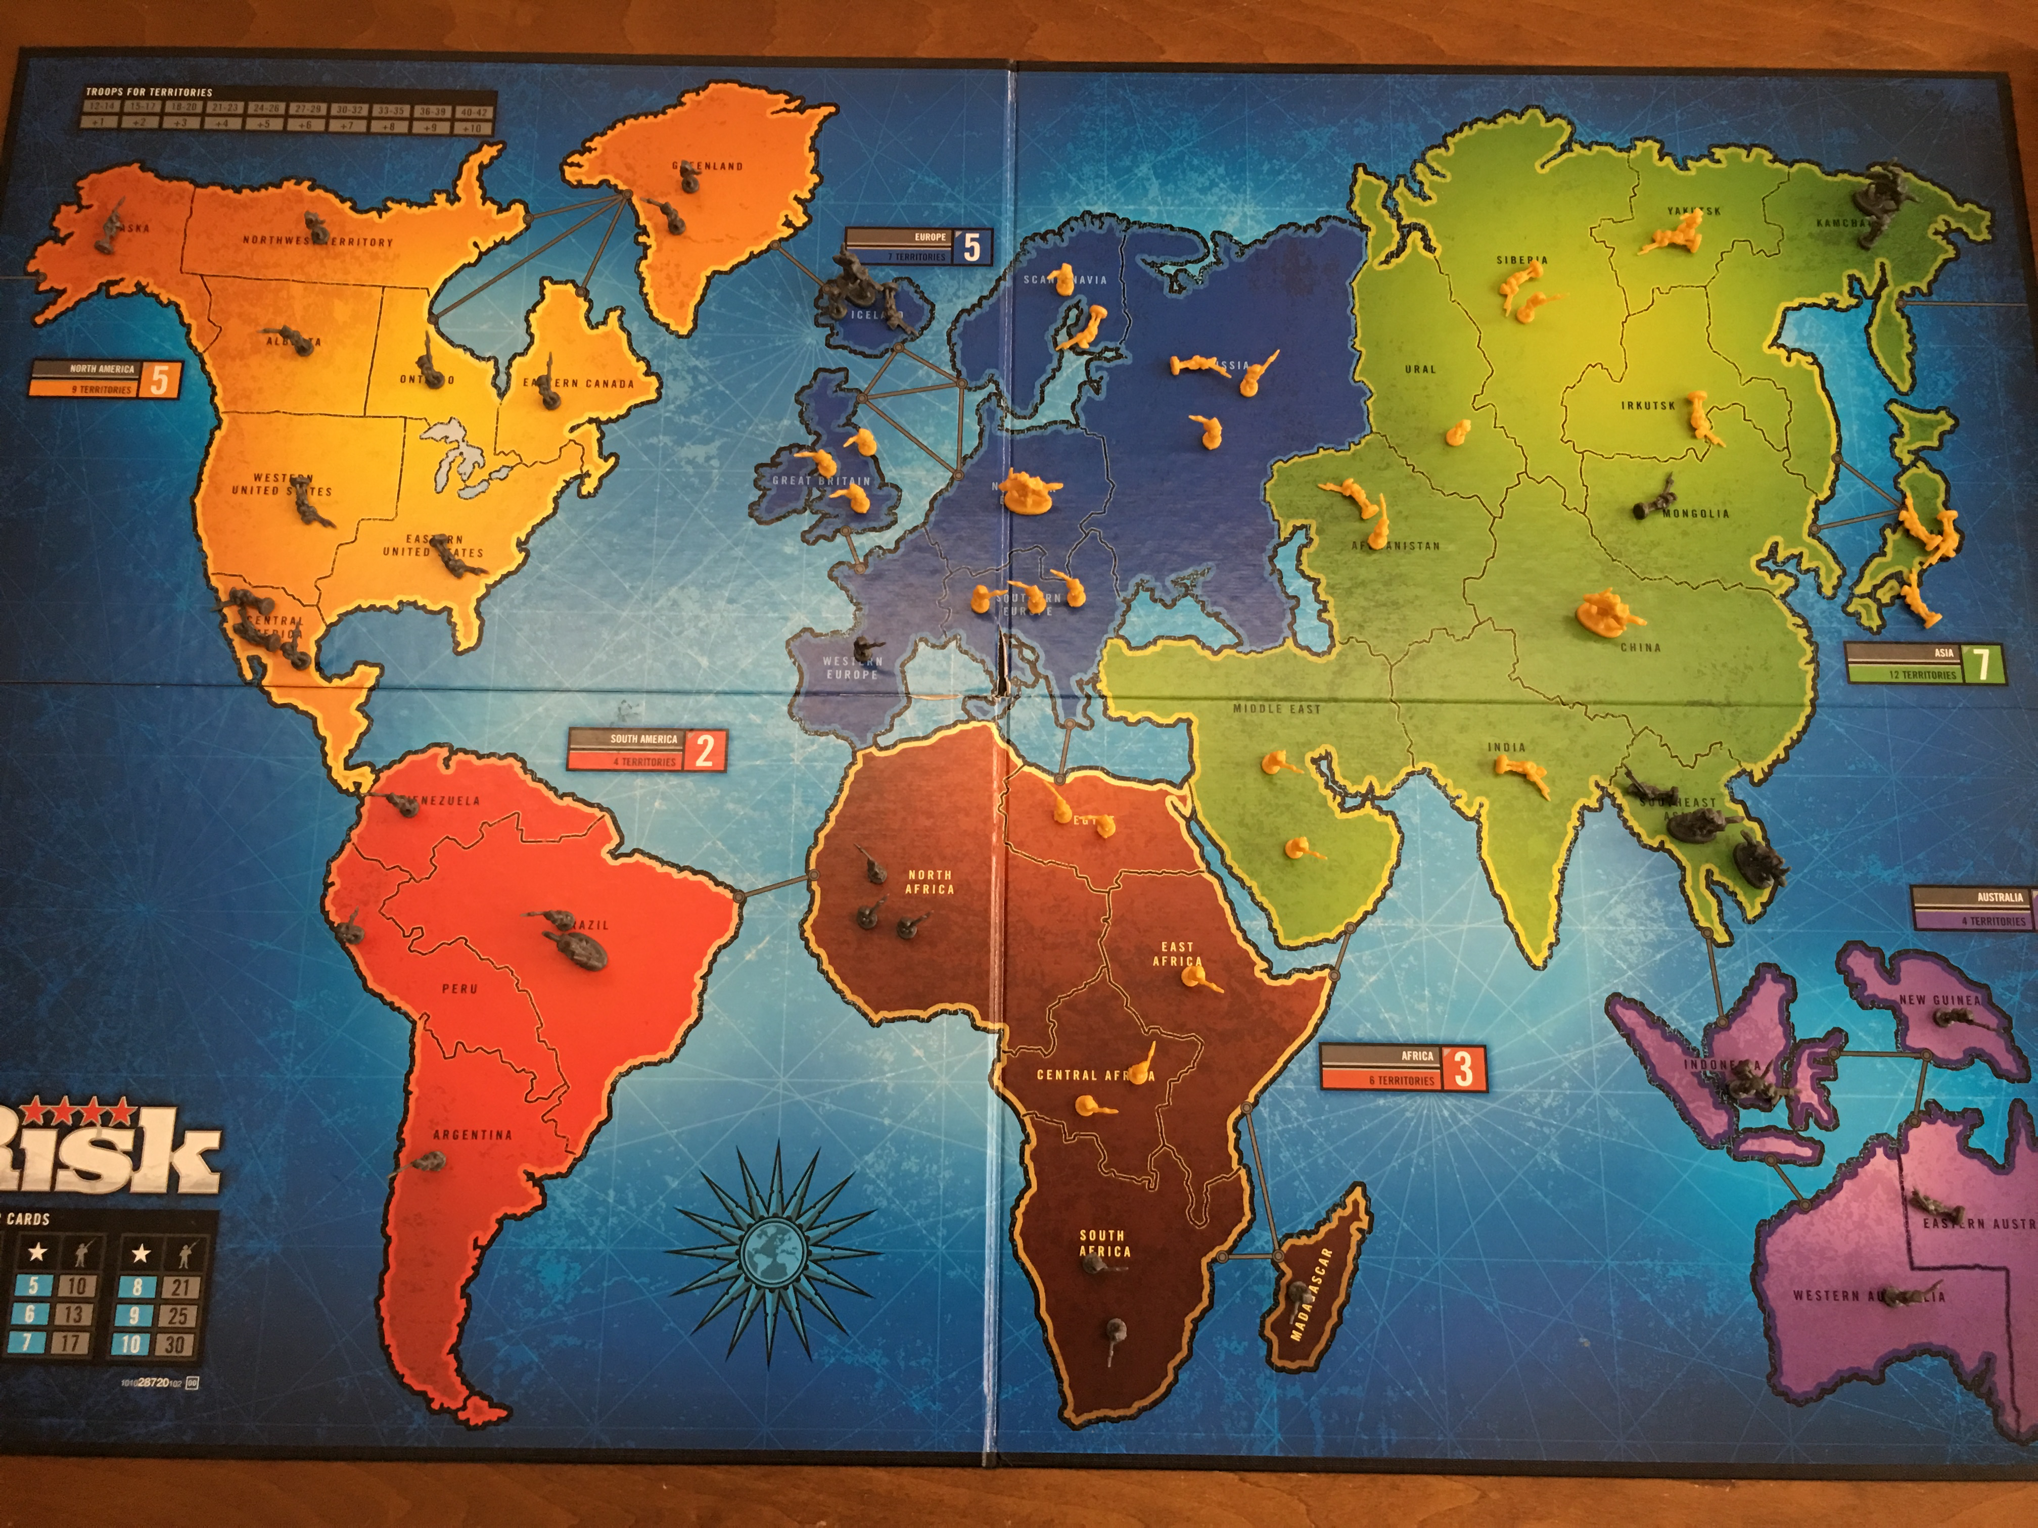
Notes:
This is actually the board from the last time we played. He is Yellow and I am Grey.
If you understand the game risk, you'll know that basically, it's a regressive game.
The person winning has the most land, and they get the most troops.
The only nod at progressive game play (that is, trying to even everyone out) is that attacking is harder than defending.
In this game, I won on the next turn, because I could see Charlie's position was over-extended, and I had a bunch of cards and you get lots of troops for continents - I’ve got 3. North and South America, and Australasia.
Now, Charlie is 12. He plays a good game of chess, but I can beat him at most other things if I want to. Now, we can get into whether or not, as a parent, you should do that another time.
I like playing games with my kids and I feel it's good for them, so I tend to let them win about half the time.
Apart from Chess, where I have to fight for my life.
Why did I know I was going to win? Basically, I have an Internal Model of Risk that's better than his. I could see the danger areas. For example, I knew that by holding Thailand down here, I would prevent him from owning Asia, which would gives him 7 extra troops each go. And by defending Kamchatka up the top I can stop him marching into the US.
But I'm taking risks too: Africa is a huge open back-door, and Charlie could have taken South America and beaten me.
In the same way as Deutsche Bank has Operational Risk, and Market Risk and Credit Risk, I have Africa Risk, and a bit of Kamchatka Risk.
That is, I can identify specific types of risk that’ll cause me to lose the game.

Slide 6
INTERNAL MODEL
Notes:
So, to win at risk, I was managing a balance of risks. And those risks are the ones I know about, in my "Internal Model".
It's possible that there are things that I'm not seeing, that a better Risk player would. The reason I beat Charlie is I am 44 and my Internal Model is a bit better developed than his.
And, I've played more Risk.

Slide 7
Notes:
Roulette is another game that's all about risk. Generally, most people have the same internal model of this game: If I put a chip down on number 12, I will get back 36 chips if it comes up.. but there are 37 slots on the wheel, because of the zero. The bank always wins on that, and so it’s everso slightly rigged against you.
So, overall, over time, I’m going to lose.

Slide 8
Notes:
But this guy, Joseph Jagger, made a ton of money in the 1880's out of Roulette because he had a better Internal Model. He sent stooges to casinos to record the results of each spin of the wheel. And he found that some wheels were biased and so certain numbers came up more often than others.
All he had to do was bet on those numbers to win.
And all he had to do to get this "improved" Internal Model, was to go out and experiment in the real world, and record some observations. He had to do what I call "Meeting Reality".

Slide 9
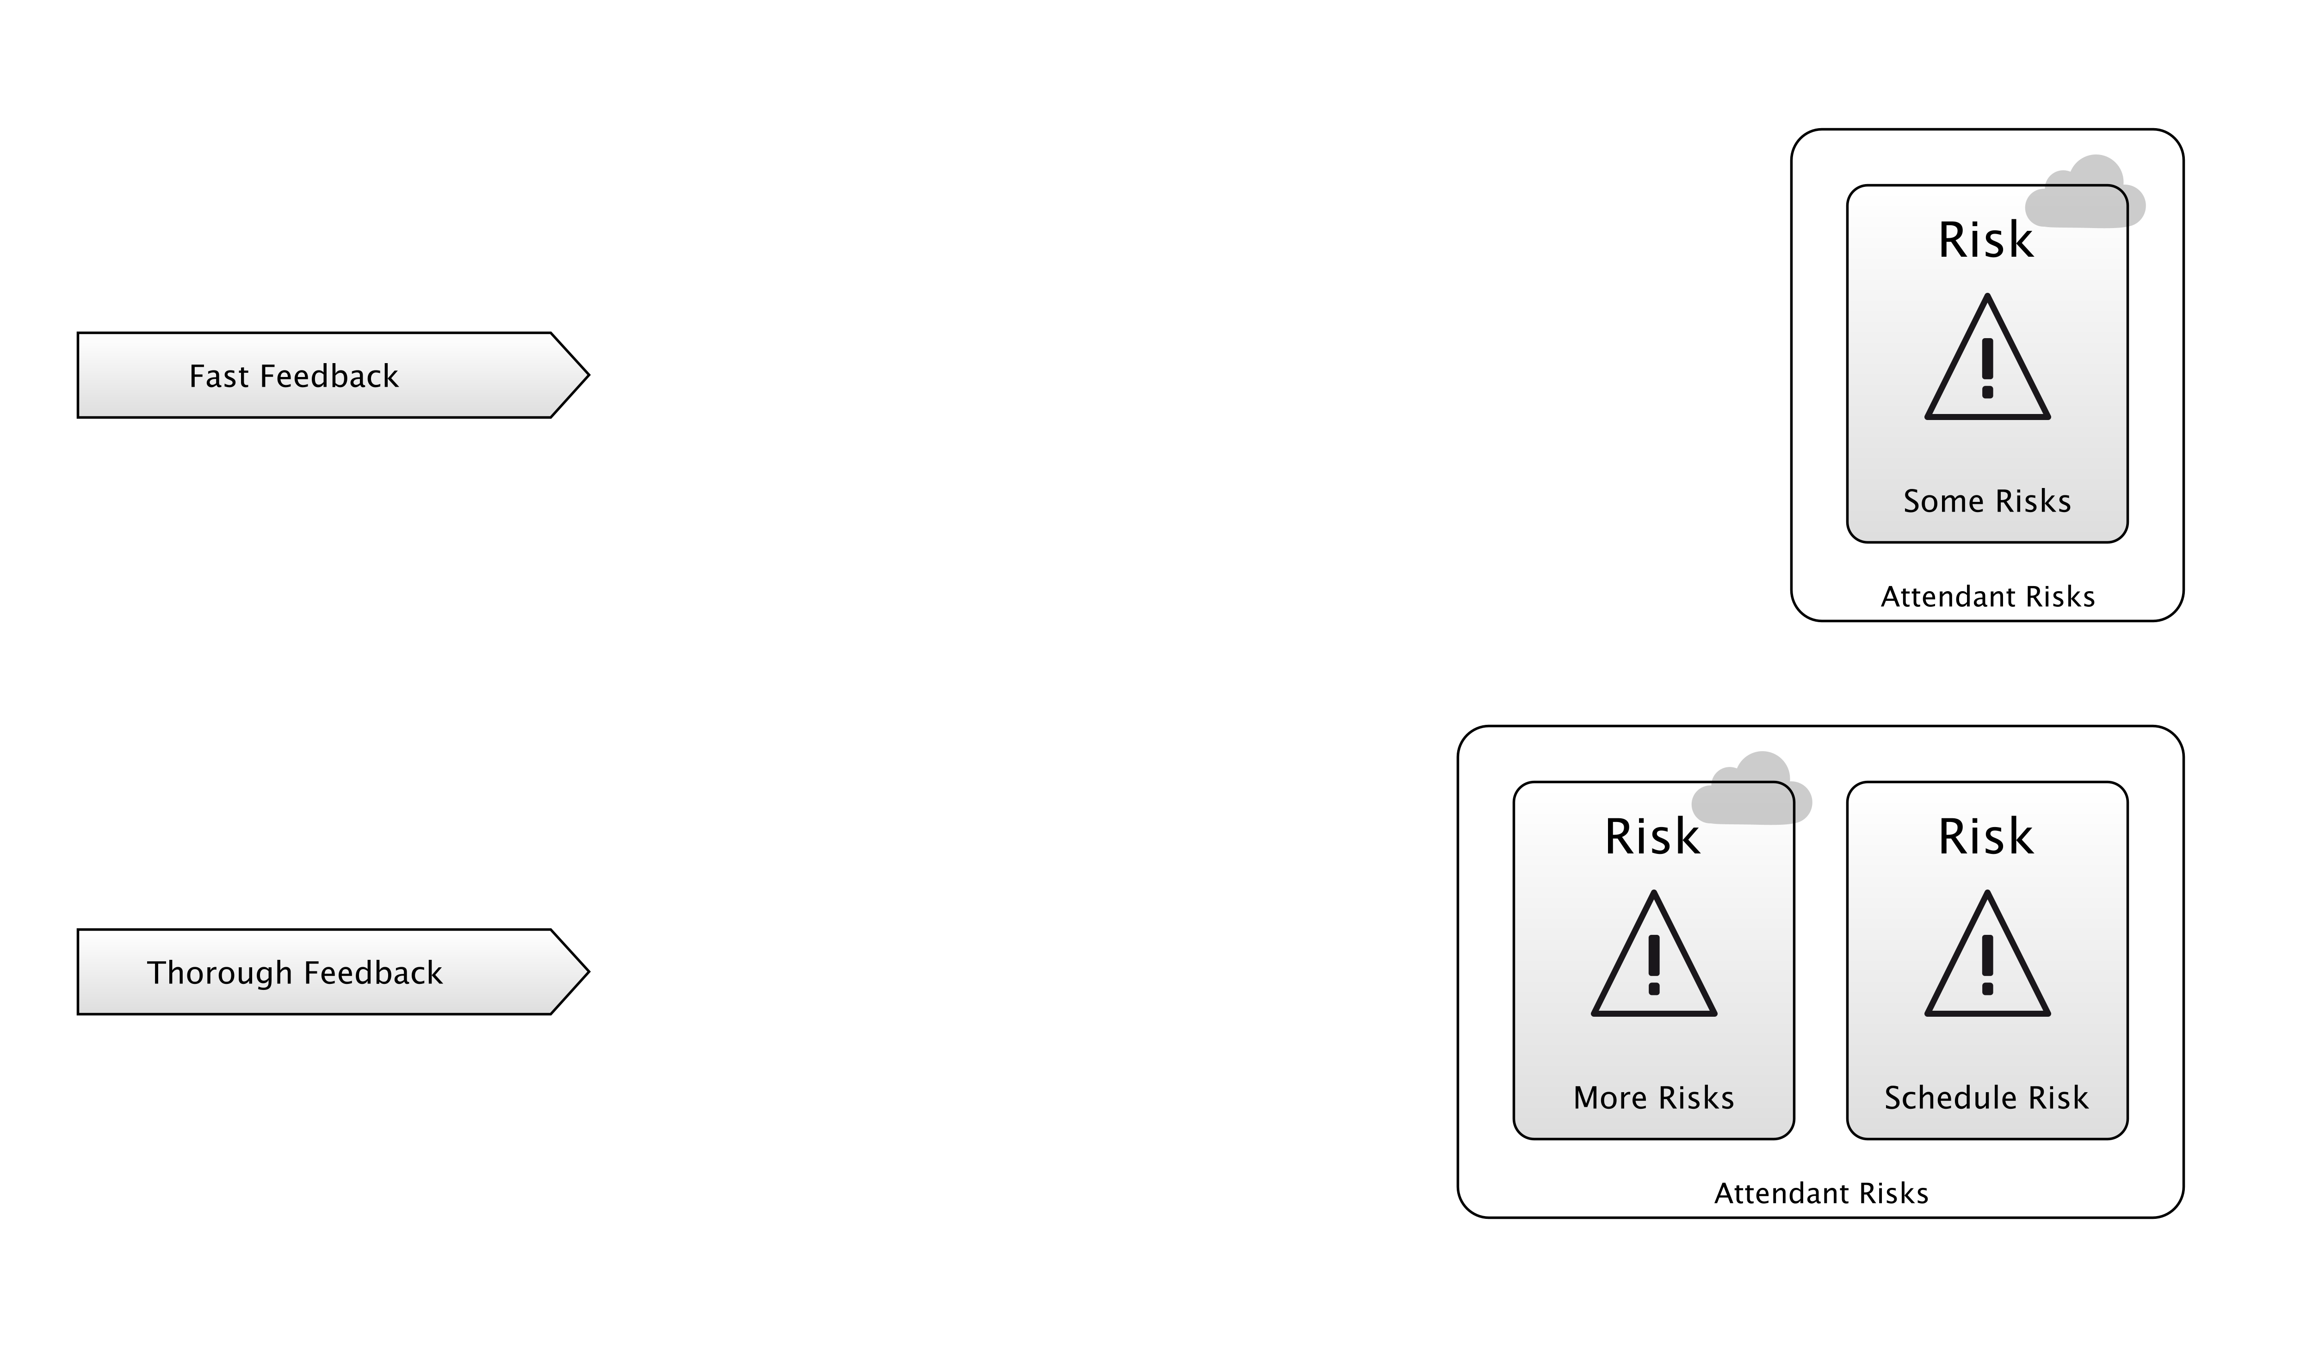
MEETING REALITY
Compilation
Unit Testing
Integration Testing
Continuous Delivery
Dog-Fooding
Monitoring Tools / Logs
Bug Reports
Feature Requests
Notes:
So, we all know feedback loops are important right?
I’ve listed some here. The “tightest” loops are at the top, the “longest” loops at the bottom. But these top ones give you “less” than the bottom ones - the Reality you meet isn’t the full, gory reality of those ones at the bottom.
Just because your code compiles, doesn’t mean people are going to enjoy using it.
But, you can find that out in a few seconds.
It might take weeks to get a feature request back from a user, or a bug report.
When you play the Risk game or learn about the Roulette wheels, you "Meet Reality” - your Internal Model improves. This is the general process whereby experience gives you a better understanding of the risks.
Does that apply to software development?
I would argue it does. Going back to Charlie, we were doing some revision for his Computer Science exam the other day, and he had to understand HTML.
He wrote a webpage that looked like this, to start with.

Slide 10
<HTML
<HEAD>
<TITLE>My Webpage
</HEAD>
<BODY>
<P>A Paragraph<P/>
<A href=“http:://google.com>Go To Google</A>
</HTML>
Notes:
Now, for most of us... this just hurts our eyes. We can see all of the problems right off. I have no idea what a browser would do with this. Browsers are very lenient so maybe some of it would work.
But the reason this sets off alarm bells for us, is that we have really well developed Internal Models of HTML and the rest.
Whereas this is Charlie's first webpage.
By loading this up in a browser, he is Meeting Reality. He’s closing a feedback loop, because he’ll see the results of his efforts.
And, his Internal Model will improve.
The next time he writes a webpage, his Internal Model will warn him about the risks of it going wrong, and he’ll make fewer mistakes.
And that process of Meeting Reality, Improving Your Internal Model, and having tight feedback loops is the essential characteristic of Agile.

